Slide 1
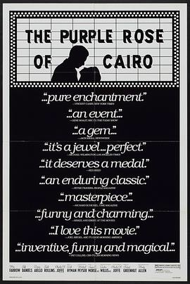

Slide 2
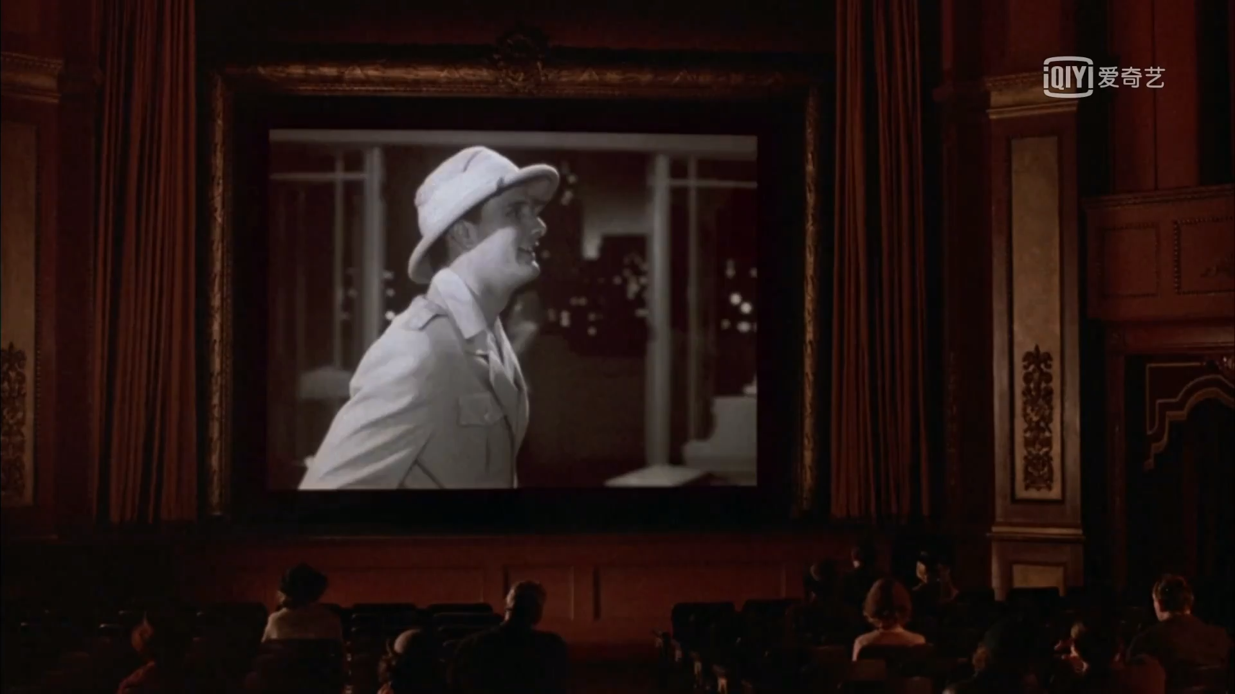

Slide 3


Slide 4

The icon

Slide 6



Slide 7


Slide 8
“
在此键入引文。
— Johnny Appleseed
”

Slide 10
About the film
donec quis nunc
Directed by Woody Allen in 1985
Comedy
It is the tale of a film character enters the real world.

